Slide 1
Algorithms

Slide 2
Algorithms
Definition:
An algorithm is a finite sequence of clear, step-by-step instructions designed to solve a specific problem or perform a task.
Key Points :
Clear – Each step must be well-defined.
Finite – An algorithm must end after a number of steps.
Deterministic – Same input → same output every time.
Effective – Solves the problem in reasonable time.
Example:
Making tea is an algorithm: Boil water → Add tea leaves → Add sugar/milk → Serve.

Slide 3
Algorithms
Importance of Algorithms
Problem Solving: Provides a structured way to think.
Efficiency: Optimized algorithms make systems faster (e.g., Google search uses efficient search algorithms).
Reusability: One algorithm can be applied to multiple tasks (sorting numbers, sorting names, sorting files).
Foundation of Computer Science:
Data structures use algorithms for operations.
AI uses learning algorithms.
Operating systems use scheduling algorithms.

Slide 4
Types of Algorithms
Sequential Algorithm
Executes steps in order, one after another.
Example: Calculate sum of two numbers.
Conditional Algorithm
Uses decision-making (if/else).
Example: Check if number is even or odd.
Iterative Algorithm
Repeats a set of steps until condition is met.
Example: Print numbers 1 to 10, Factorial calculation.

Slide 5
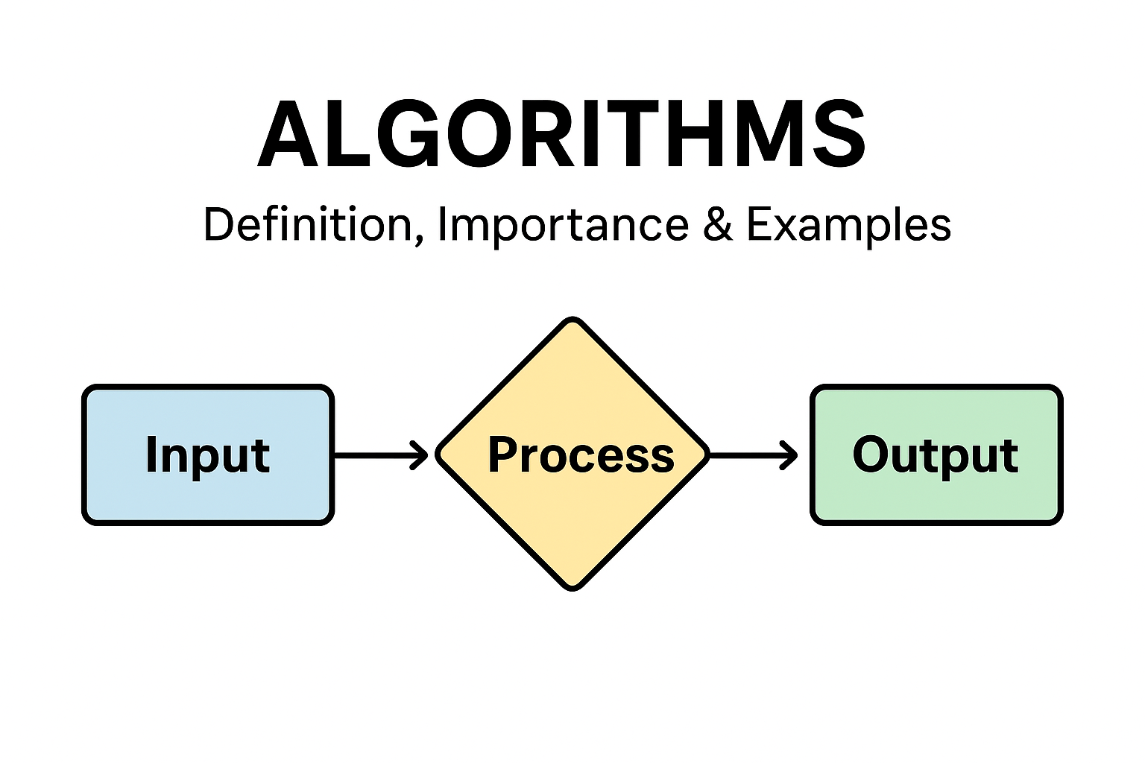
Algorithms
Inputs, Process, and Outputs
Every algorithm can be broken into 3 parts:
Input: The raw data provided.
Process: Logical steps applied to the input.
Output: The final result produced.
Example: Finding Largest Number
Input: Two numbers A, B
Process: Compare A and B
Output: Print the larger number

Slide 6
finding Largest Number
Start
Input two numbers A, B
If A > B, then print A is largest
Else print B is largest
Stop

Slide 7
Algorithms
Task 1: Factorial (Iterative)
Start
Read n
Set result = 1
Repeat multiply until n = 0
Print result
Stop

Slide 8
Algorithms
Writing Algorithms for Simple Tasks
Sorting Numbers (Bubble Sort)
Start
Read array
Compare adjacent elements, swap if needed
Repeat until no swaps
Print sorted array
Stop

Slide 9
Algorithms
Writing Algorithms for Simple Tasks
Check Even/Odd
Start
Read number n
If n mod 2 = 0 → Print “Even”
Else → Print “Odd”
Stop

Slide 10
Algorithms
Example – Sorting Algorithms
Sorting = Arranging data in order (ascending/descending).
Bubble Sort (simple): Compare adjacent elements and swap if out of order. Repeat until sorted.
Insertion Sort: Insert elements into their correct position one by one.
Merge Sort / Quick Sort: Divide & conquer approach, more efficient.
Real-world Use: Sorting names in contacts, sorting search results by relevance.

Slide 11
Algorithms
Searching Algorithms
Searching = Finding a specific element in a dataset.
Linear Search:
Check elements one by one.
Works on unsorted data.
Time: O(n).
Binary Search:
Works on sorted data only.
Repeatedly divide list in half.
Much faster → O(log n).
Real-world Use: Search in Google, finding files in directories.

Slide 12
Algorithms
Summary
Algorithms = Step-by-step instructions.
Important for problem solving, efficiency, reusability.
Types: Sequential, Conditional, Iterative.
Applications: Sorting, Searching, Factorials, Decision-making.
Algorithms are foundation of programming & computer science.

Slide 13
Pseudocode

Slide 14
Pseudocode
Definition
A language-agnostic, human-readable description of an algorithm.
Looks like code, but does not follow a specific programming language’s syntax.
Purpose
Plan algorithms before coding (focus on logic, not syntax).
Communicate ideas clearly among programmers, students, and stakeholders.
Teach algorithmic thinking.
Serve as readable documentation for complex logic.
What it’s not
Not executable directly.
Not tied to data types or language-specific details unless you choose to include them.

Slide 15
Pseudocode
Keyword | Meaning
START / END | Beginning and end of algorithm
INPUT | Accept data from user
OUTPUT | Display result
SET / ASSIGN | Assign value to variable
IF … THEN … ELSE | Decision making
WHILE … DO | Loop until condition fails
FOR … TO … | Loop for a fixed number of times
REPEAT … UNTIL | Loop that executes at least once
CALL | Invoke a function/procedure

Slide 16
Pseudocode
Translating Flowcharts into Pseudocode Map flowchart symbols to code-like constructs:
Start/End (oval) → BEGIN … END
Process (rectangle) → assignments or calculations (SET x ← …)
Input/Output (parallelogram) → READ/PRINT
Decision (diamond) → IF … THEN … ELSE … ENDIF (or WHILE for repeated decision)
Arrows → execution order (sequence)
Loops:
Pre-check loop (decision before body) → WHILE condition DO … ENDWHILE
Post-check loop (decision after body) → REPEAT … UNTIL condition

Slide 17
Pseudocode
Steps to translate:
List the flowchart’s steps in order of arrows.
Convert each shape using the mapping above.
Preserve the exact decision conditions and which branch is “true/false.”
Use indentation to show nesting/branches.
For repeated decision diamonds that form a cycle, choose WHILE or REPEAT…UNTIL based on whether the condition is checked before or after the body.

Slide 18
Pseudocode
Example A (pre-check loop):
BEGIN
READ n
SET sum ← 0
SET i ← 1
WHILE i ≤ n DO
SET sum ← sum + i
SET i ← i + 1
ENDWHILE
PRINT sum
END

Slide 19
Pseudocode
Post-check loop example (keep reading numbers until user enters 0):
BEGIN
SET total ← 0
REPEAT
READ x
SET total ← total + x
UNTIL x = 0
PRINT total
END

Slide 20
Pseudocode
Find Factorial of a Number
START
INPUT number
SET factorial = 1
FOR i FROM 1 TO number
SET factorial = factorial * i
END FOR
OUTPUT factorial
END

Slide 21
Pseudocode
Check Even or Odd
START
INPUT num
IF num MOD 2 = 0 THEN
OUTPUT "Even"
ELSE
OUTPUT "Odd"
END IF
END

Slide 22
Pseudocode
Linear Search
START
INPUT list, target
SET found = FALSE
FOR i FROM 1 TO length of list
IF list[i] = target THEN
OUTPUT "Found at position", i
SET found = TRUE
EXIT FOR
END IF
END FOR
IF found = FALSE THEN
OUTPUT "Not Found"
END IF
END

Slide 23
Pseudocode
Bubble Sort
START
INPUT list of n numbers
FOR i FROM 1 TO n-1
FOR j FROM 1 TO n-i
IF list[j] > list[j+1] THEN
SWAP list[j], list[j+1]
END IF
END FOR
END FOR
OUTPUT sorted list
END

Slide 24
Pseudocode
Advantages of Pseudocode
Easy to learn and use.
Enhances logical thinking.
Can be quickly converted into any programming language.
Reduces development time.
Limitations of Pseudocode
No formal standard – writing style may differ.
Not executable by computers.
Can sometimes oversimplify complex logic.

Slide 25
Flow chart

Slide 26
Definition of Flowcharts
A flowchart is a graphical representation of a process, system, or algorithm.
It uses symbols and arrows to show the sequence of steps and the decision points.
Flowcharts help visualize logic, simplify complex processes, and improve understanding.
Importance of Flowcharts
Clarity & Communication: Simplifies complex ideas for better understanding.
Problem-Solving Tool: Helps in breaking down a process step by step.
Documentation: Acts as a reference for system design and processes.
Error Detection: Makes it easier to identify gaps, bottlenecks, or redundant steps.
Training & Learning: Useful in teaching new employees or students about a proces

Slide 27
Real-World Applications of Flowcharts
Software Development: Representing algorithms before coding.
Business Processes: Workflow diagrams for HR, Finance, or Sales operations.
Education: Teaching problem-solving and logical thinking.
Engineering & Manufacturing: Process optimization, quality control.
Healthcare: Patient admission and treatment procedures.
Project Management: Visualizing task sequences and decision points.s.
Common Flowchart Symbols
Symbol | Meaning
Oval (Start/End) | Indicates beginning or end of a process
Parallelogram (Input/Output) | Represents input (e.g., user enters data) or output (e.g., print result)
Rectangle (Process) | A task, operation, or step in the process
Diamond (Decision) | A condition with Yes/No or True/False outcome

Slide 28
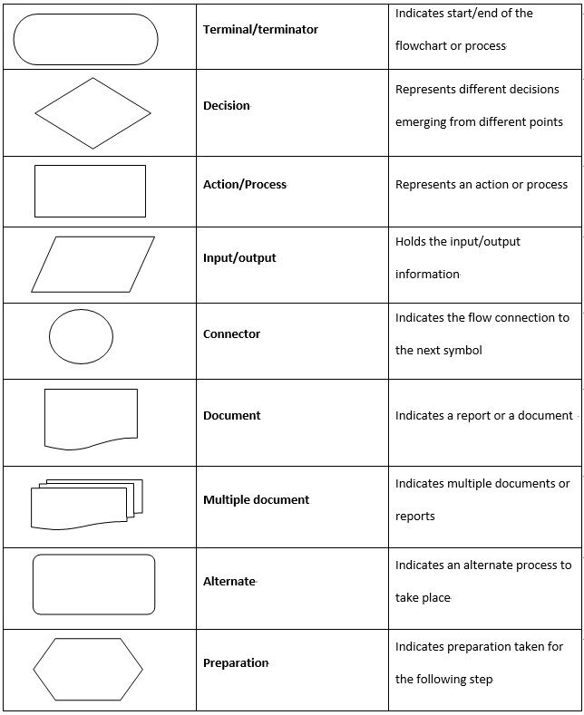
Common Flowchart Symbols

Slide 29
Step-by-Step Approach to Designing Flowchar
Understand the problem/process clearly.
List all steps in sequential order.
Identify decision points (Yes/No, True/False).
Choose the correct symbols for each step.
Draw the flow using arrows to connect steps.
Review & Refine to check clarity and correctness.

Slide 30
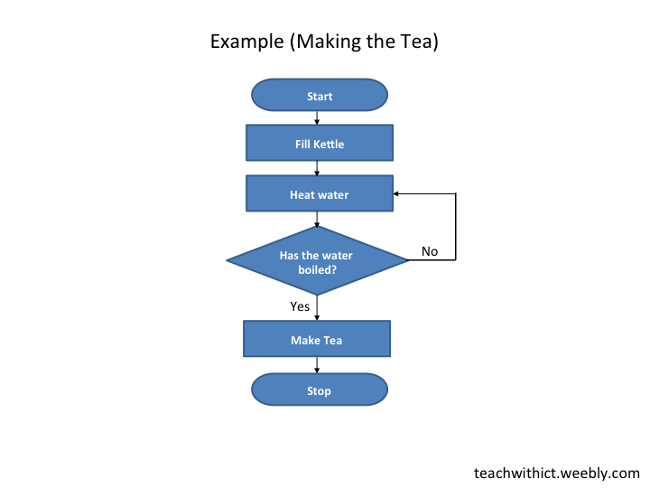
Example Making Tea

Slide 31
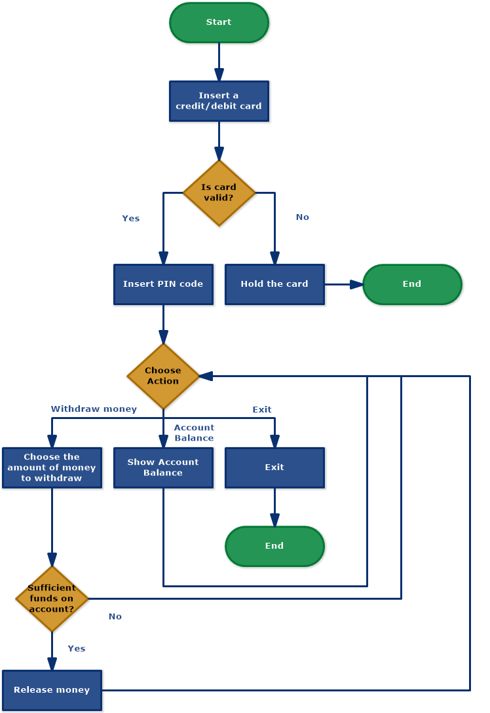
Diagram for Cash Withdrawal from ATM

Slide 32
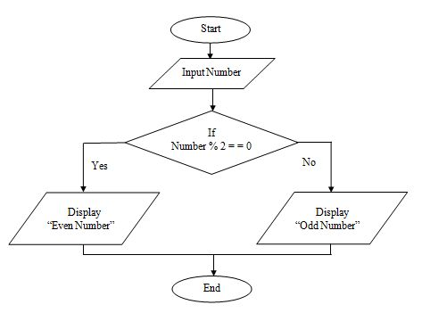
Flowchart to check Odd or Even Number

Slide 33
Summary
Flowcharts are essential tools for problem-solving, documentation, and communication.
They use standard symbols to represent processes and decisions.
Widely used in software, business, engineering, education, and healthcare.
A step-by-step design method ensures clear and effective flowcharts.
Practice makes it easier to visualize and simplify complex tasks.

